Slide 1
An integration of maps, photographs and physically persistent reference points on the landscape of West Waterfront of Sturgeon Bay (Sawyer).
Showing a plausible depiction of the early 1900s as it relates to current day streets and parcels.
Notes:
Title page:
An animation depicting the West Waterfront of
Sturgeon Bay (Sawyer) in the early 1900 as it
relates to current day streets and parcels.

Slide 2
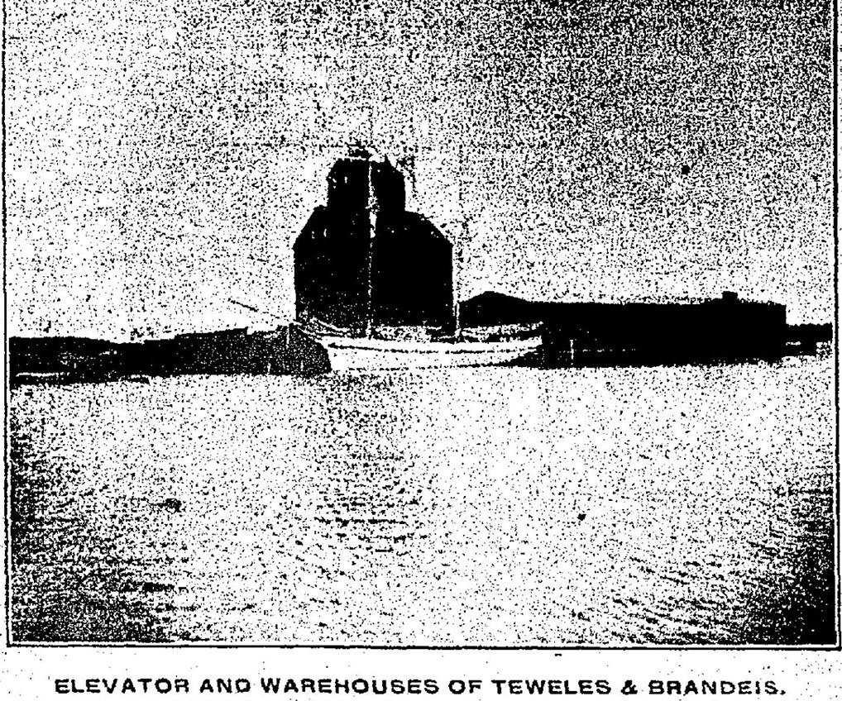
Picture from
Door County Democrat
22 October 1904
Notes:
1904 news photo – Label “22 October 1904”

Slide 3
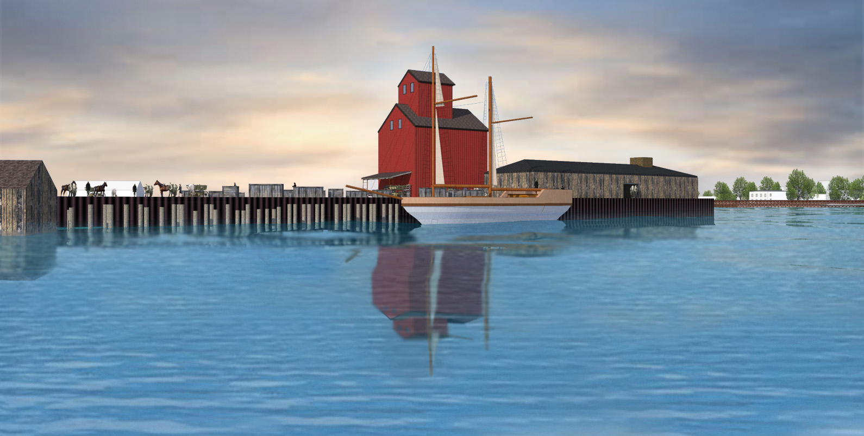
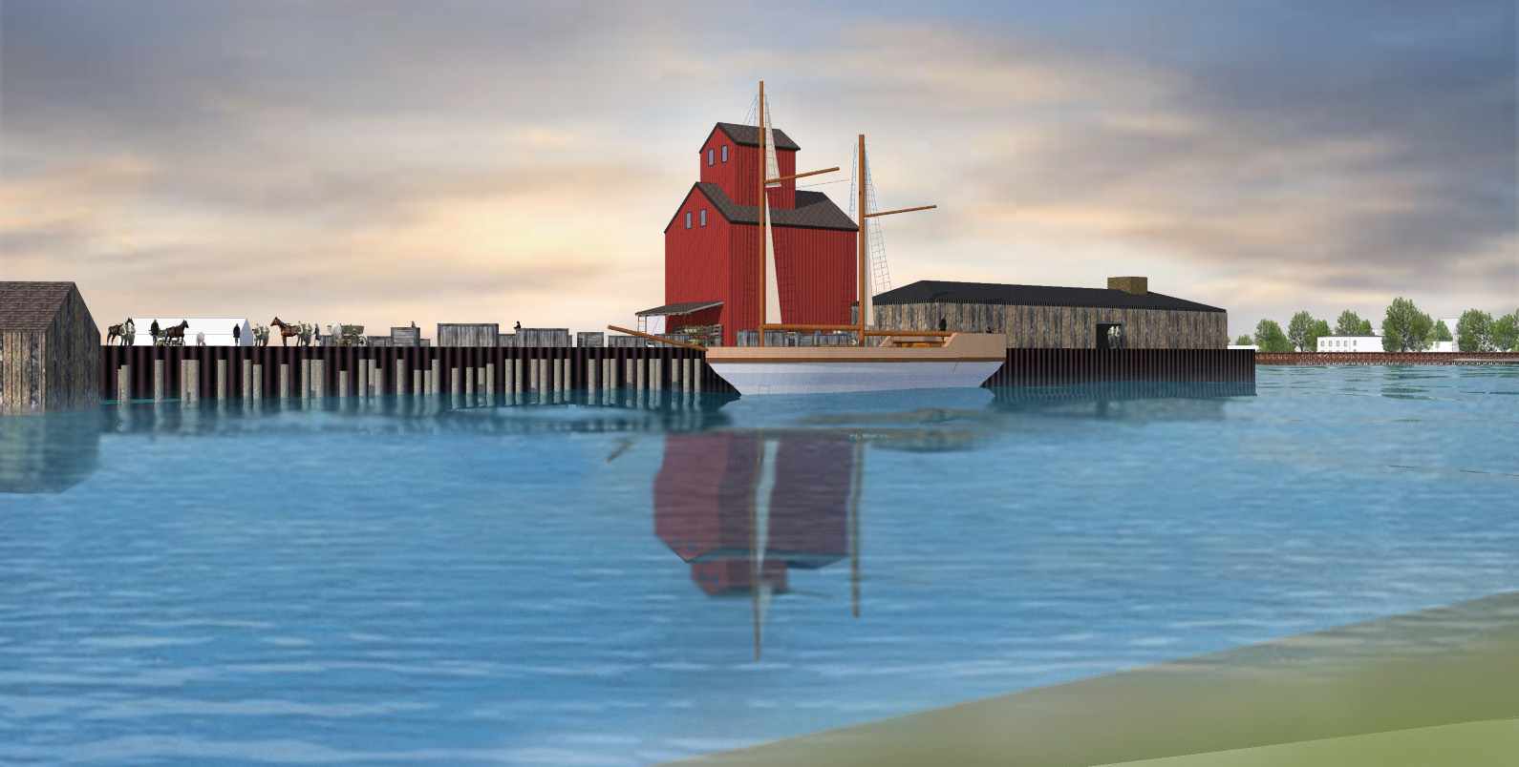
1904 Model
1904 Model

Slide 4
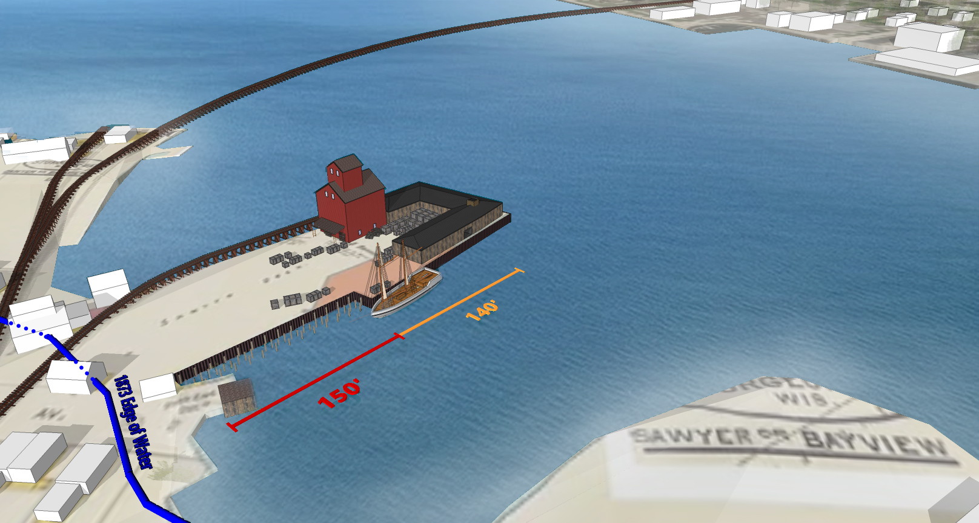
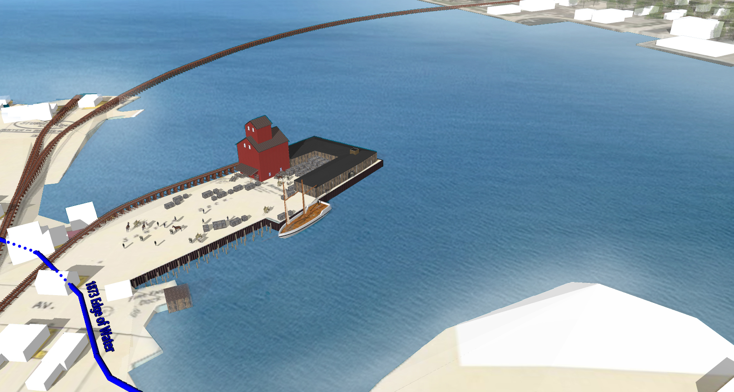
1904 Model
1873 water edge added in Blue
per 1873 Bay View Plat
Notes:
Pan up approx. 200’, east approx. 200’ with
140/150 measurements as shown at right.

Slide 5
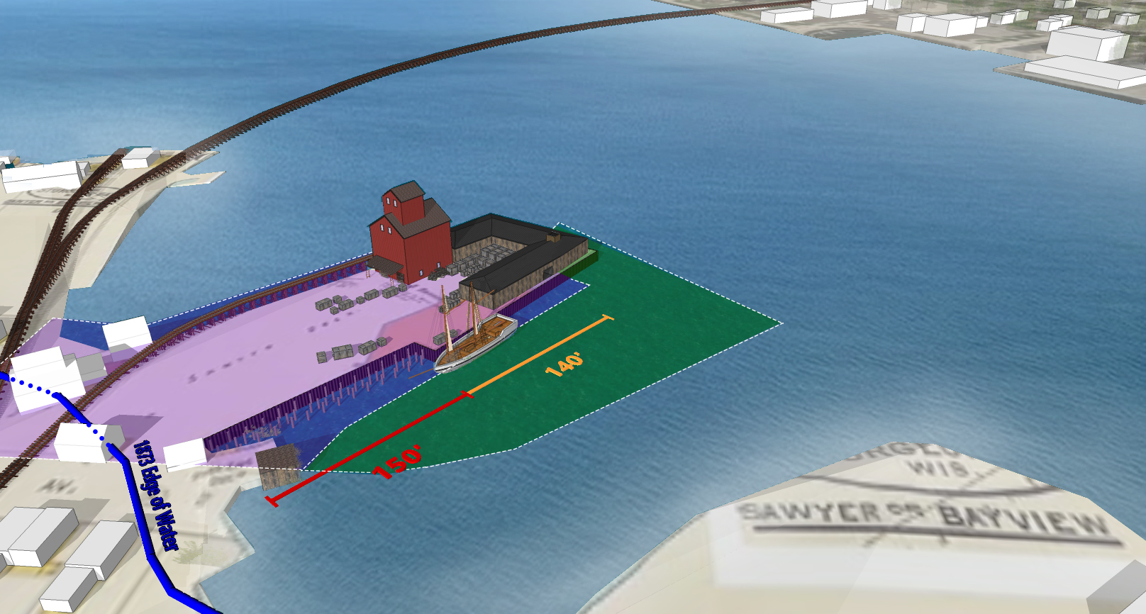
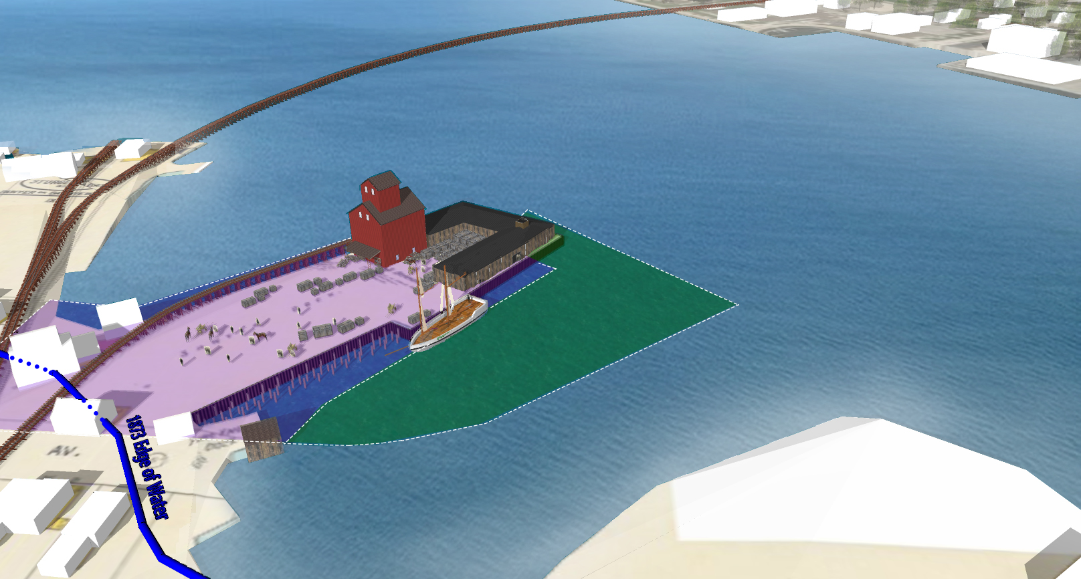
1904 Model
with present day parcels 92 violet/blue and 100 green
Notes:
Pan up approx. 200’, east approx. 200’ with
140/150 measurements as shown at right.
Bleed out text, bleed in modern parcels 92 & 100
and text “1904 waterfront shown with present
day parcels 92 and 100”.

Slide 6
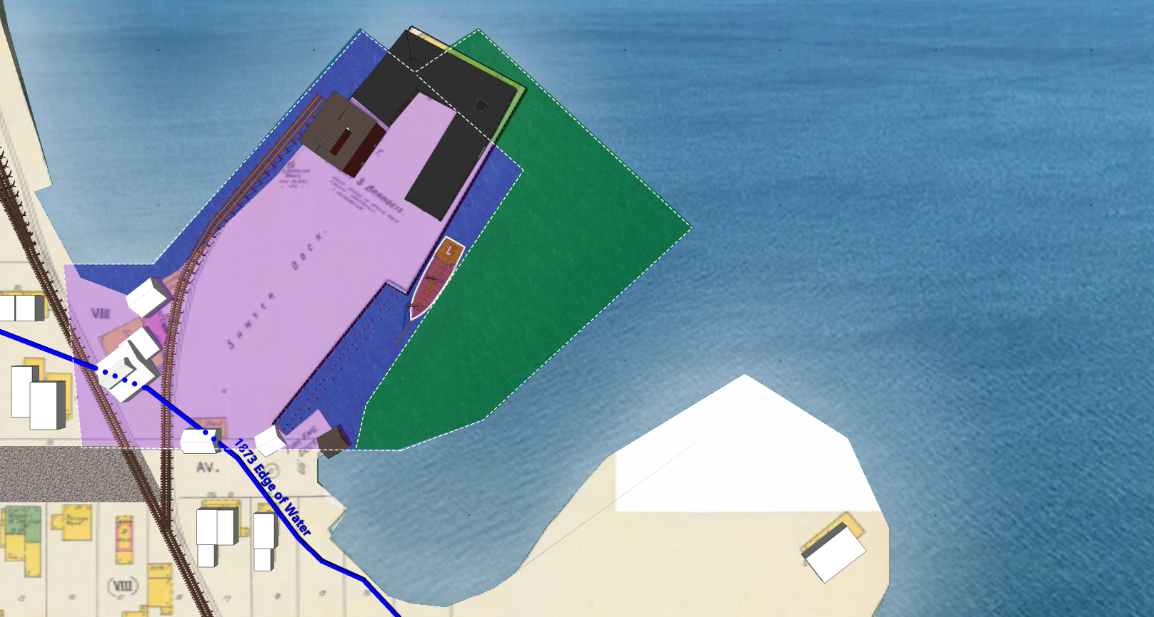
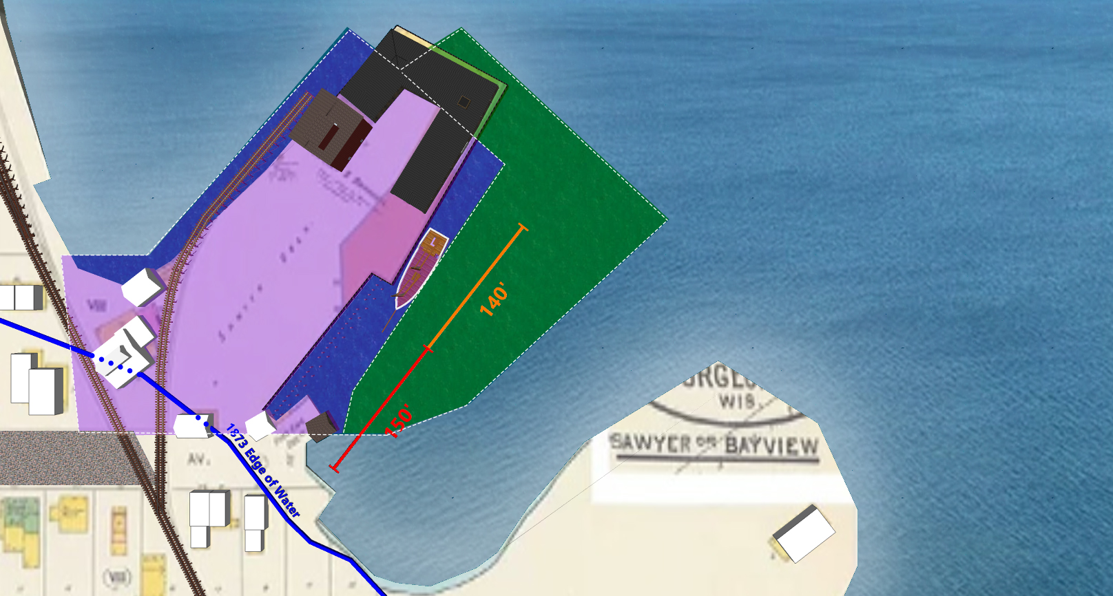
1904 Model overhead view with 1904 Sanborn base map
Notes:
Pan directly overhead to emphasis 1904 Sanborn

Slide 7
1904 Sanborn map with parcel 92 Red

Slide 8
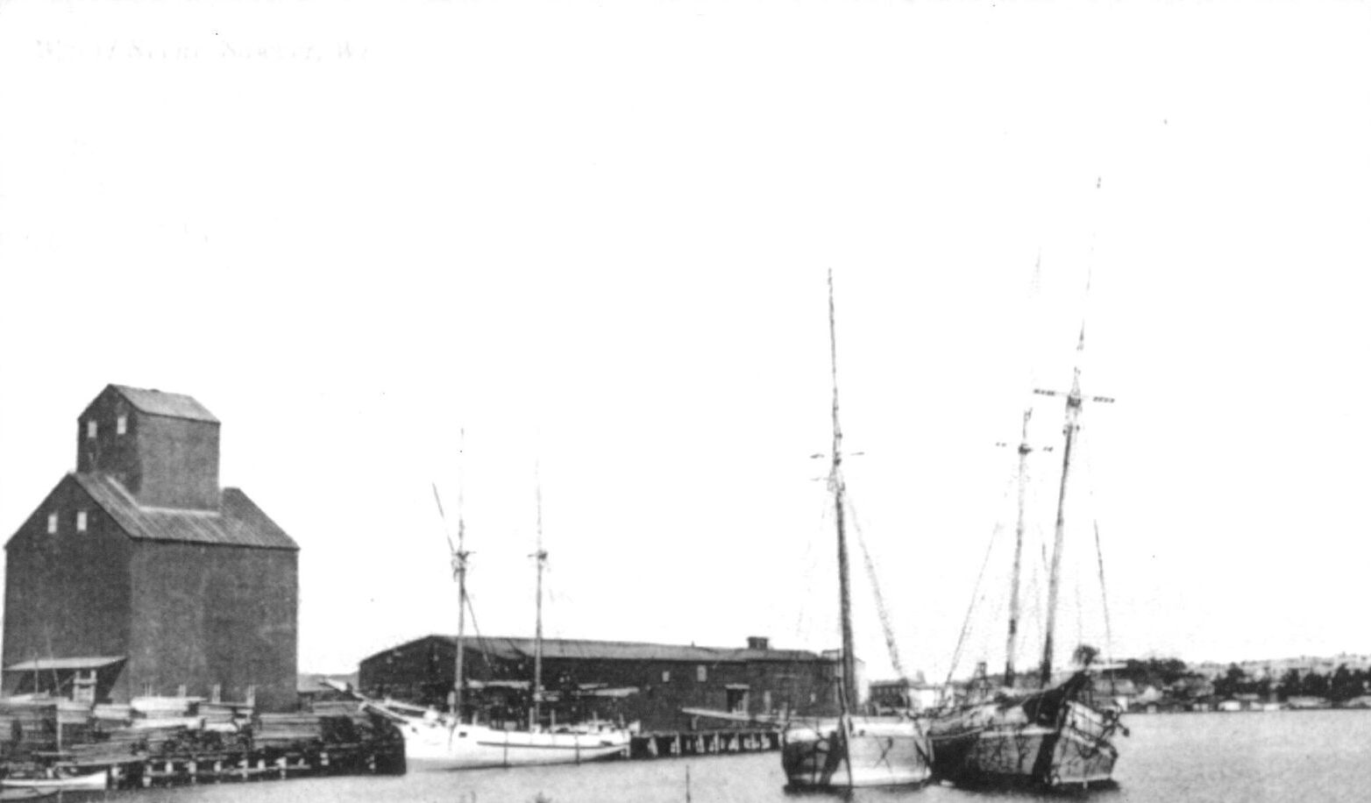
Door
County
Historical
Museum
Photo
1911
Notes:
Pan down to bleed into “Schroeder photo”
(moving the schooner to fit Schroeder photo)

Slide 9
1908 Model
1908 Model
Notes:
Bleed out of Schroeder, now showing 1908 ACE as base map and dock outline. Text ” 1908
22 October 1904 Door County Democrat: ‘The dock as a frontage of 140 feet , and extends 150 feet out from the shore, the
water being deep enough to accommodate the largest craft.
1904 shown with modern parcels.
waterfront from Army Corp of Engineers Map”

Slide 10
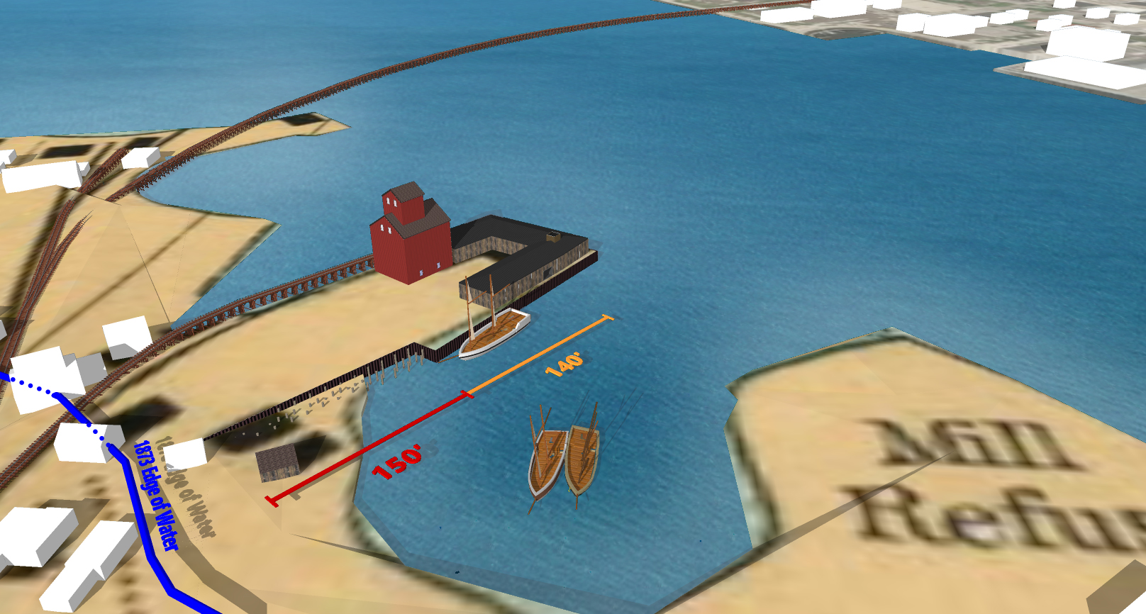
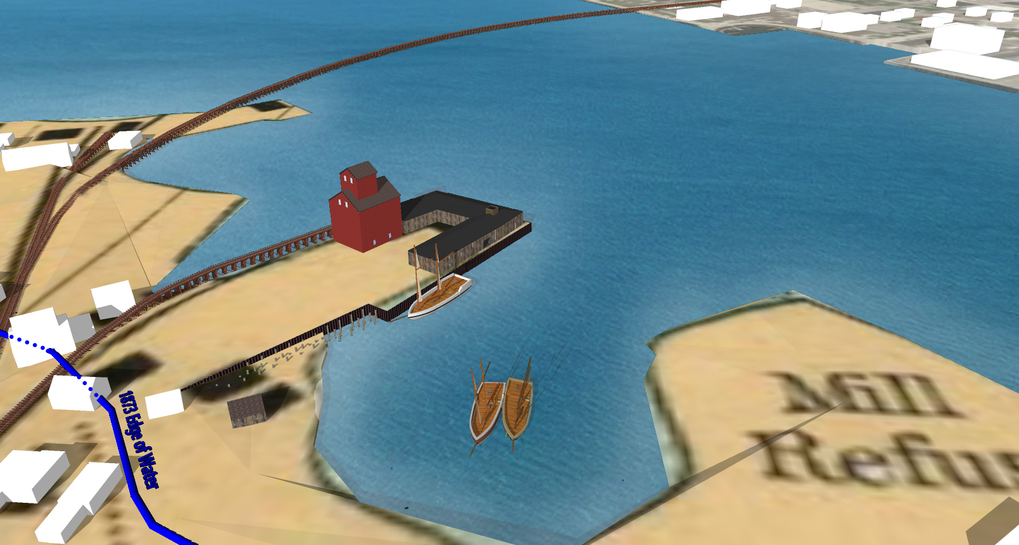
1908 Model
1908 Waterfront from Water Army Corps of Engineers map
Notes:
Bleed out of Schroeder, now showing 1908 ACE as base map and dock outline. Text ” 1908
22 October 1904 Door County Democrat: ‘The dock as a frontage of 140 feet , and extends 150 feet out from the shore, the
water being deep enough to accommodate the largest craft.
1904 shown with modern parcels.
waterfront from Army Corp of Engineers Map”

Slide 11
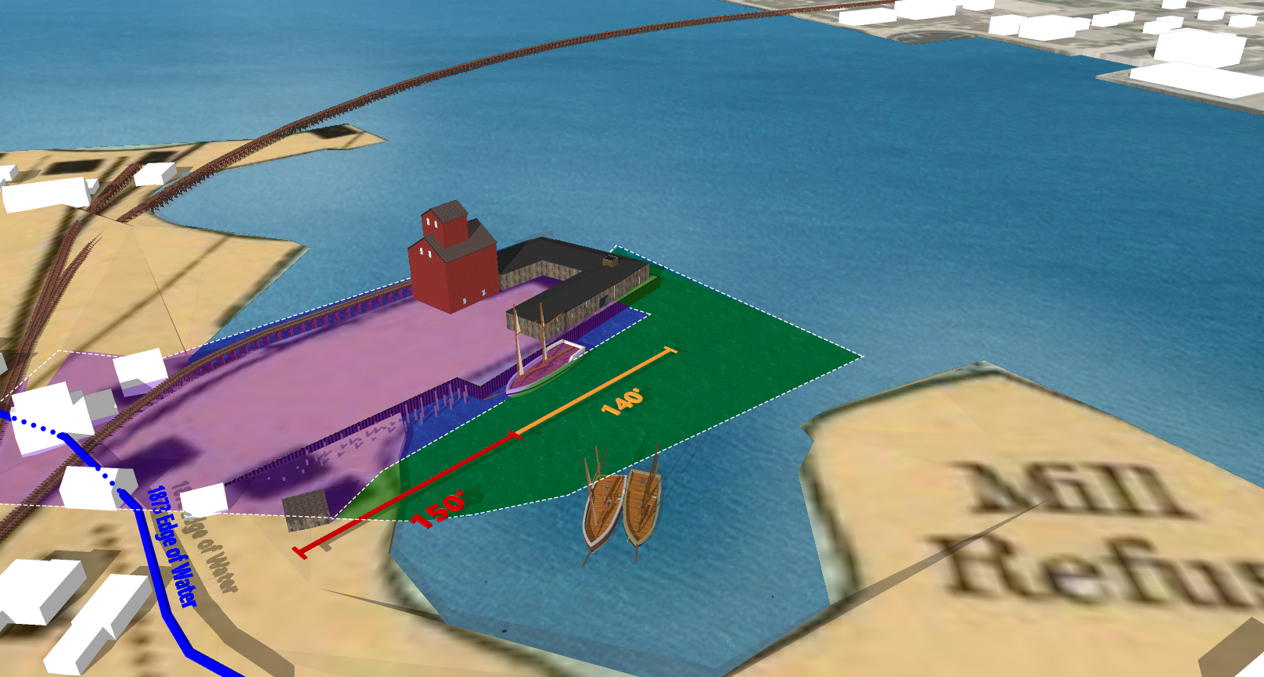
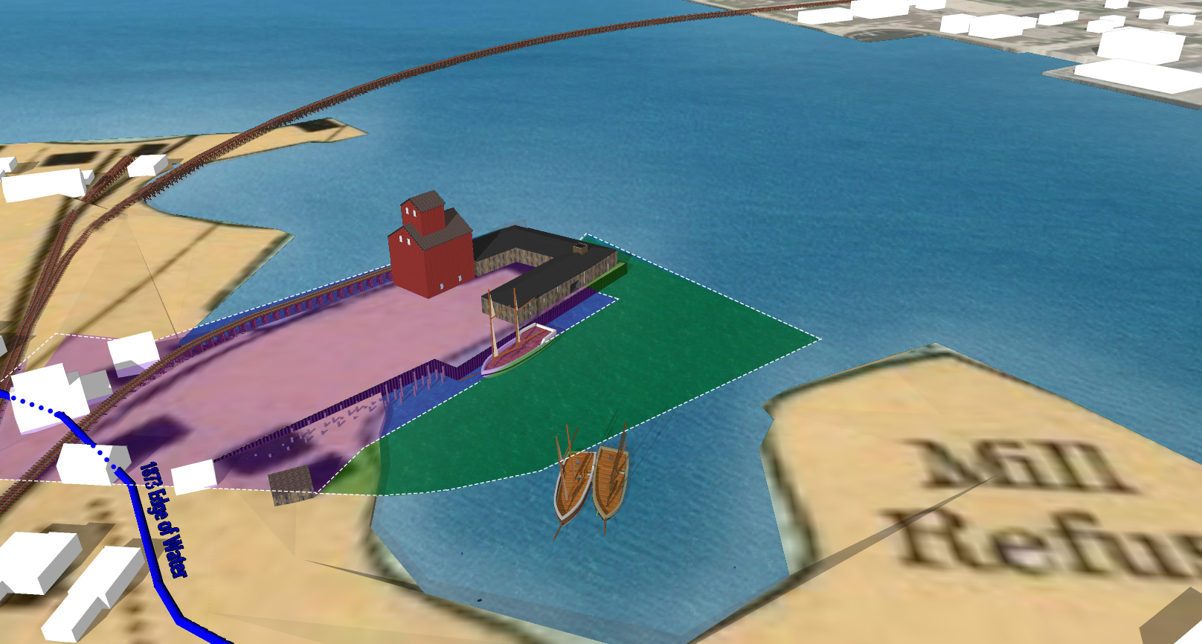
1908 Model with present day parcels 92 violet/blue and 100 green
1908 waterfront shown with present day parcels 92 blue and 100 green
Notes:
Bleed out of Schroeder, now showing 1908 ACE as base map and dock outline. Text ” 1908
22 October 1904 Door County Democrat: ‘The dock as a frontage of 140 feet , and extends 150 feet out from the shore, the
water being deep enough to accommodate the largest craft.
1904 shown with modern parcels.
waterfront from Army Corp of Engineers Map”

Slide 12
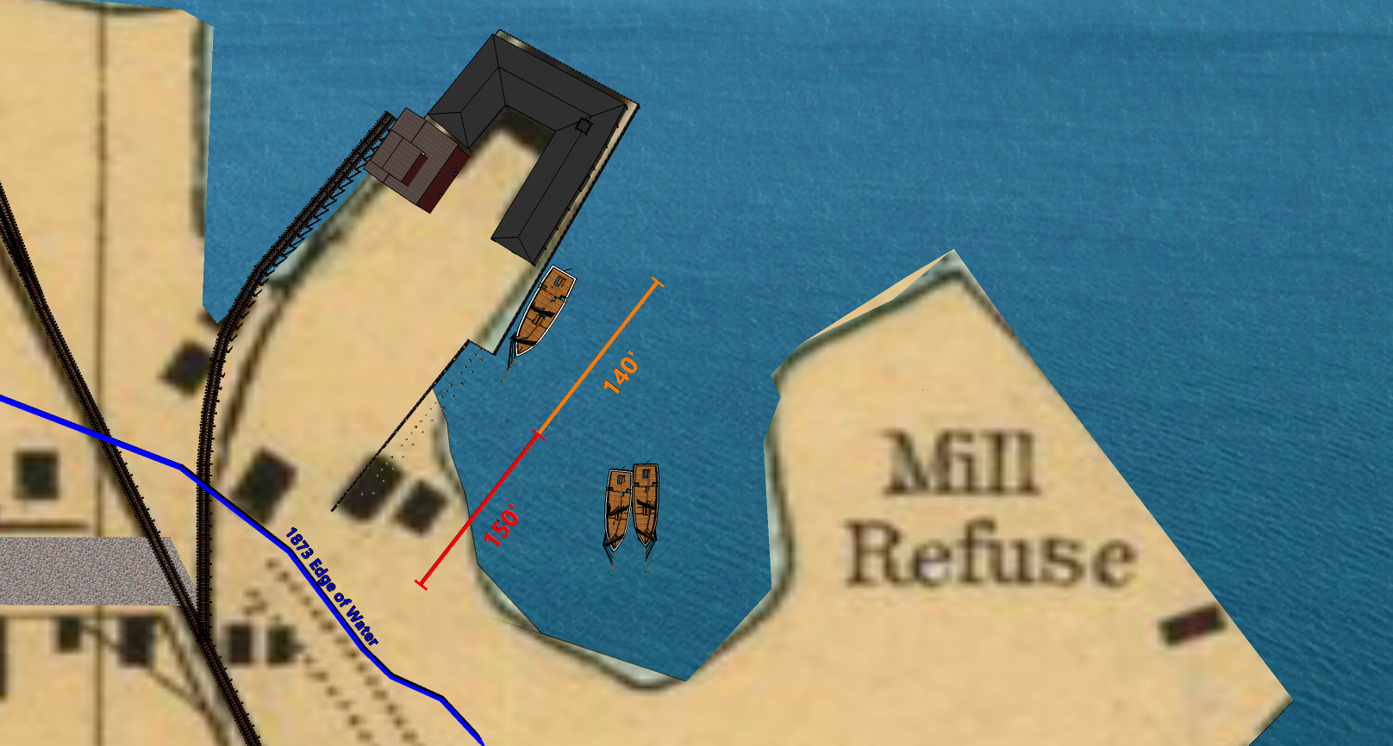
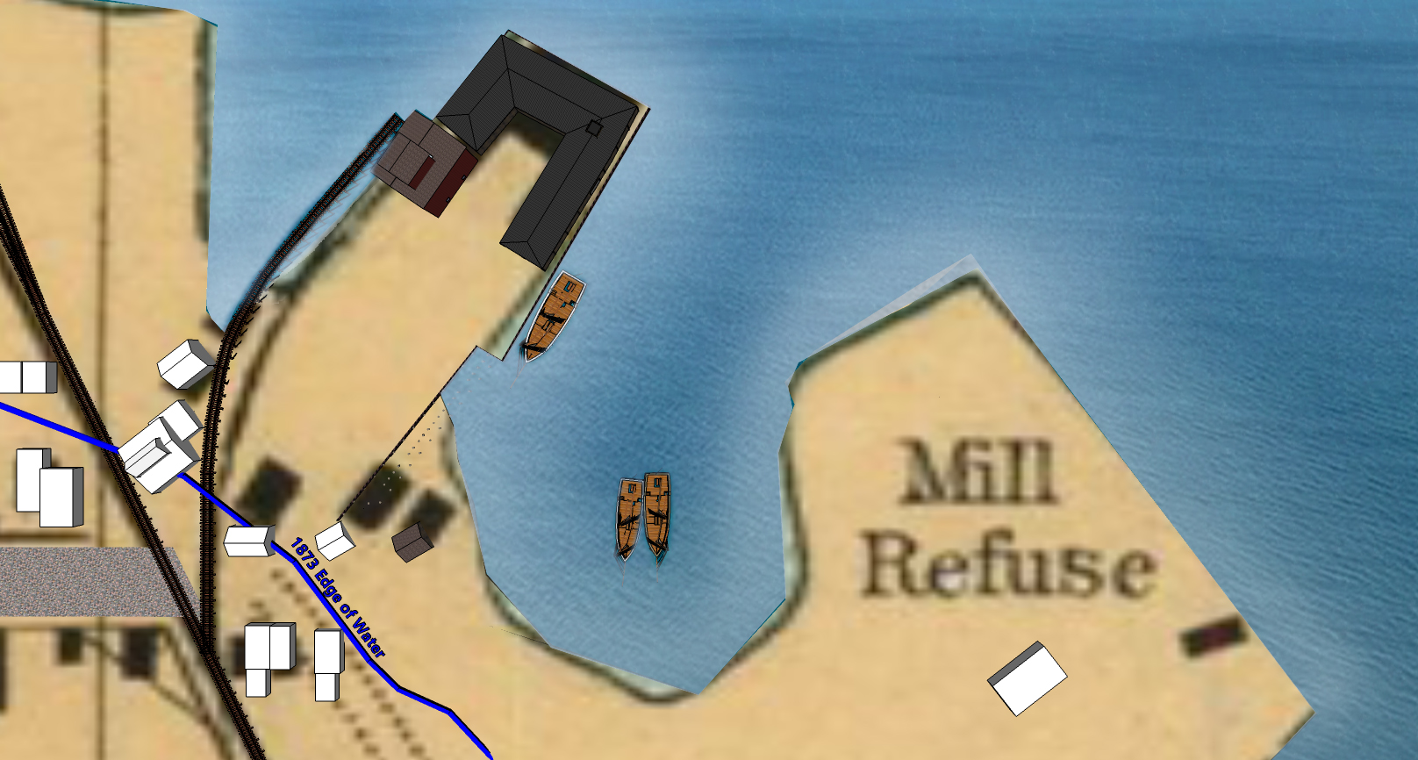
1908 Model overhead view
Dock shown with 1908 ACE base map
Notes:
Pan directly overhead to emphasis 1908 ACE

Slide 13
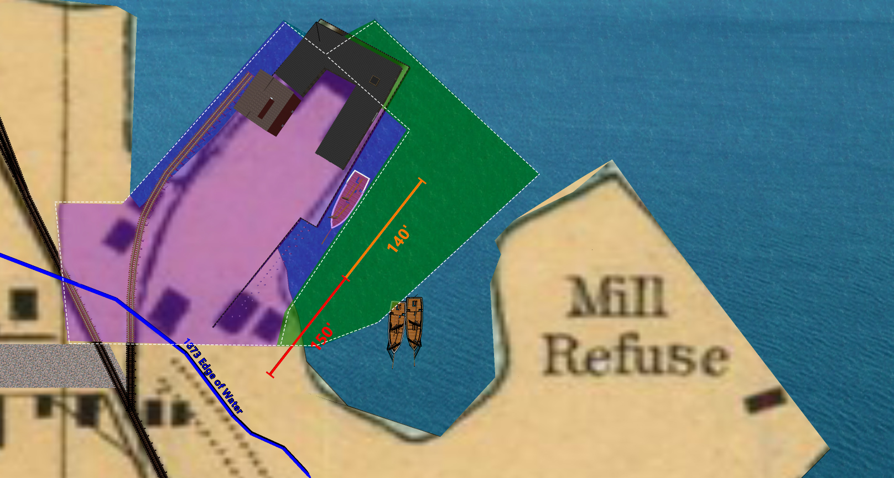
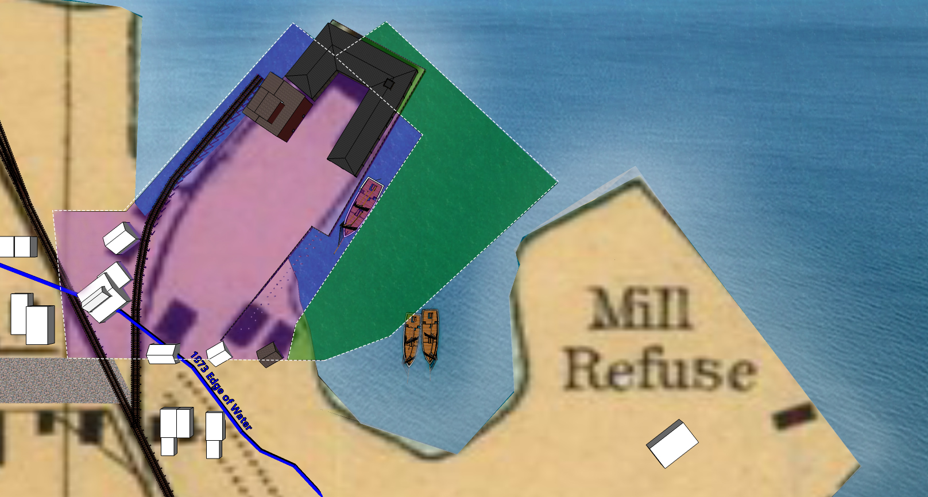
1908 Model overhead view with present day parcels 92 violet/blue and 100 green
Dock shown with 1908 ACE base map Parcel 100 violet/blue, 92 green
Notes:
Pan to view shown in #3, but using 1908 map
with parcels 92 & 100 overlay.

Slide 14
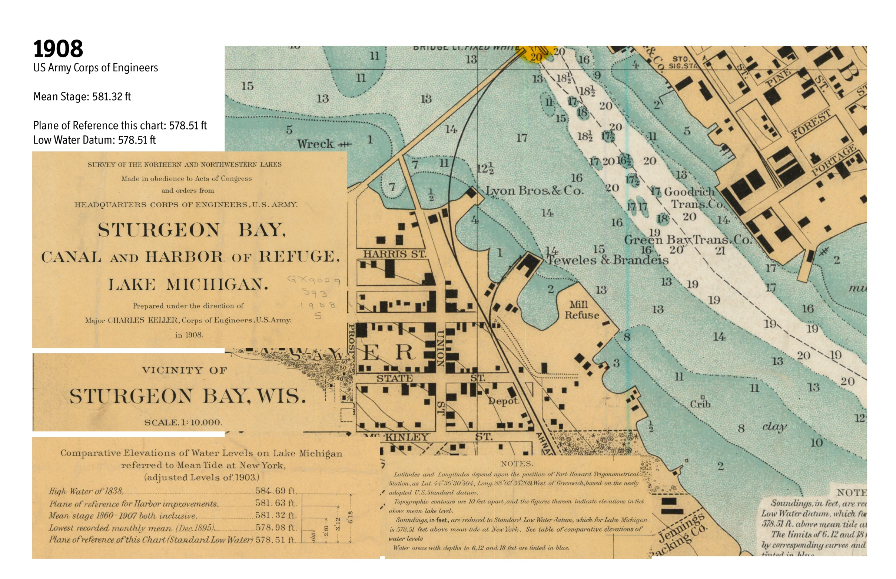
Dock shown with 1908 ACE base map
1908 Army Corp Map
Notes:
Pan directly overhead to emphasis 1908 ACE

Slide 15
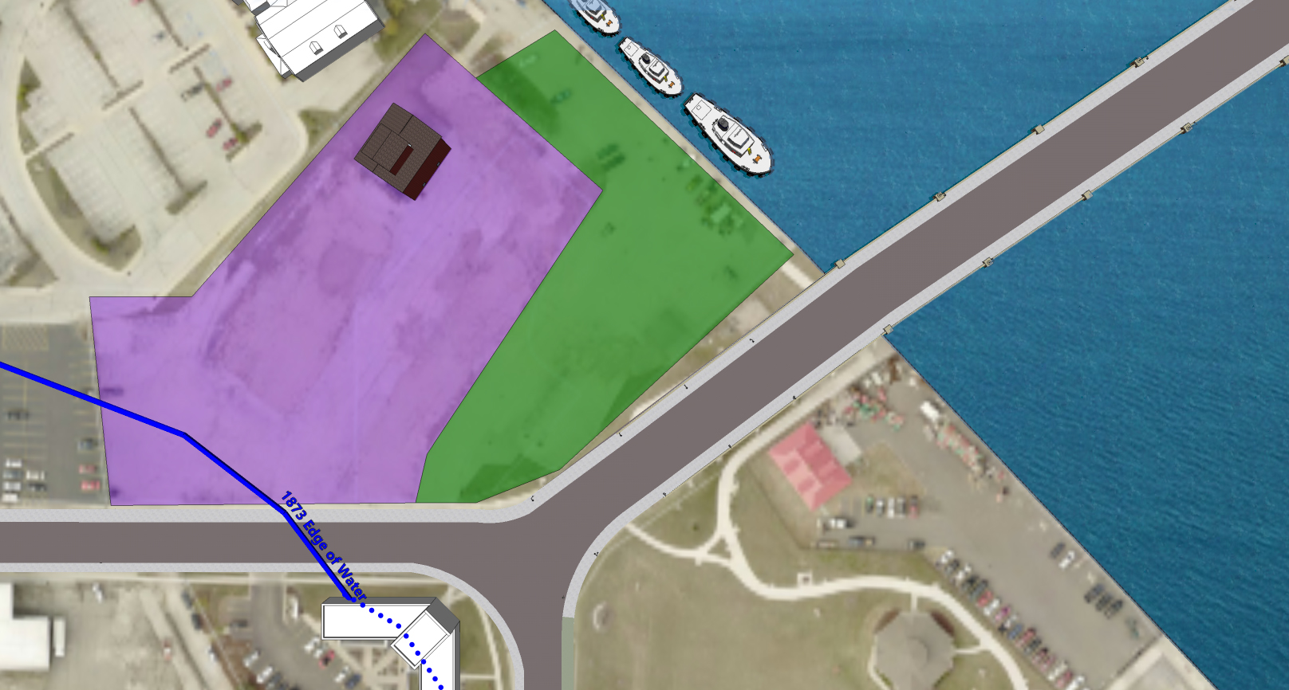
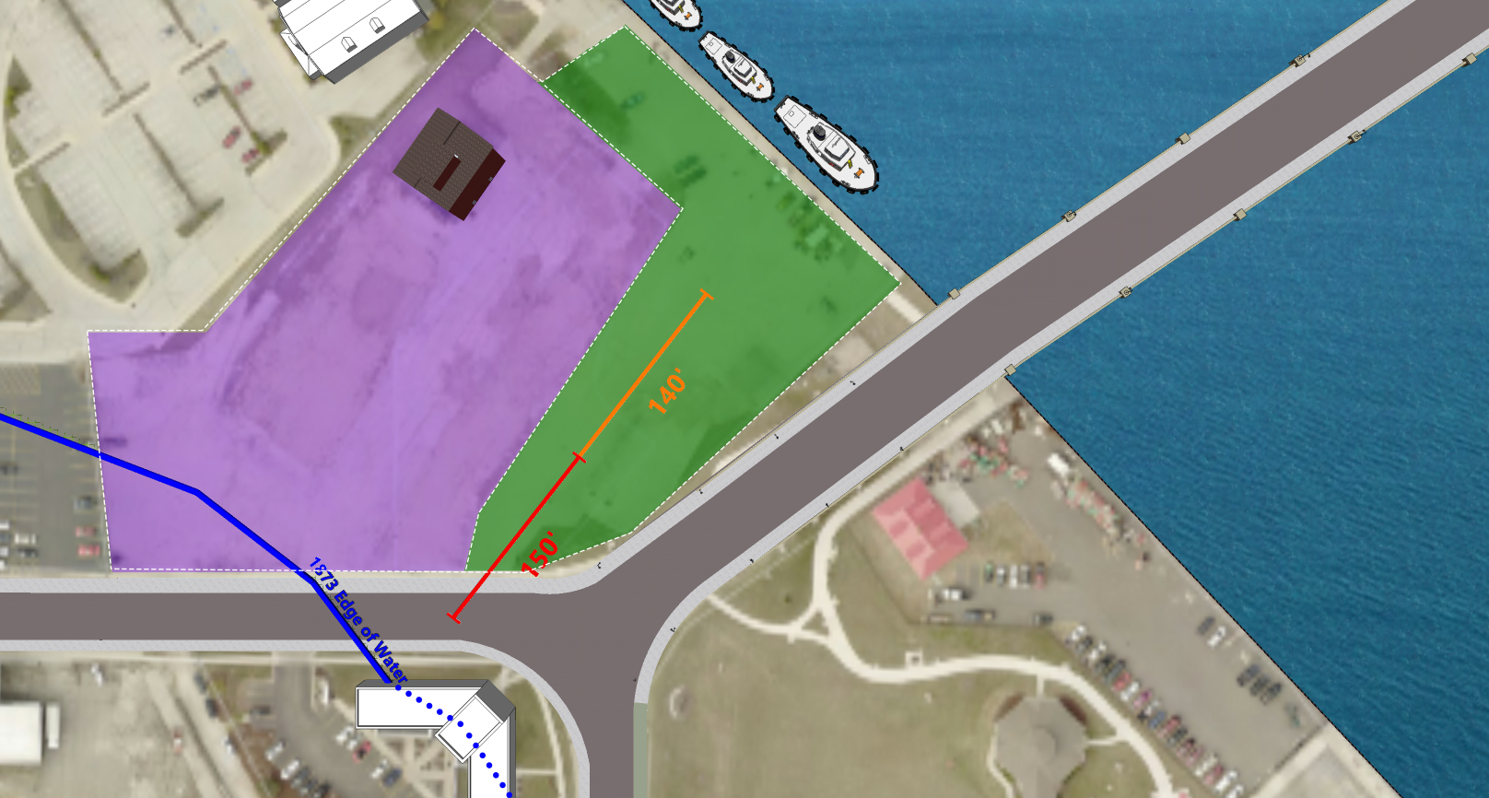
Parcels 92 & 100 shown with current base aerial photo
Notes:
Bleed base map to high res 2017 map with
parcels 92 & 100 overlay.

Slide 16
22 October 1904
Notes:
1904 news photo – Label “22 October 1904”

Slide 17
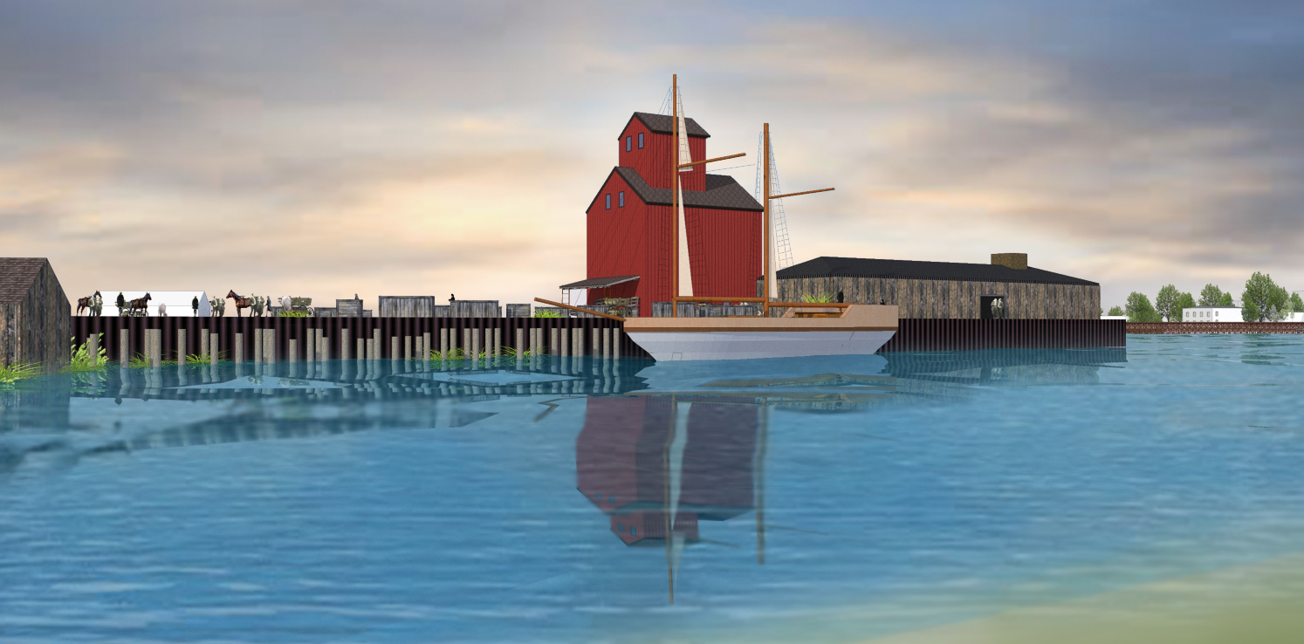
1904 Model
1904 Model
Notes:
Pan to “start” view,

Slide 18
18 August 2017
Notes:
Bleed to 2017 photo (if that looks ok). Label “18
August 2017

Slide 19
References cited:
1. Door County Democrat October 22nd 1904
2. 1904 Sturgeon Bay Sanborn Map
3. 1908 Army Corp of Engineers Sturgeon Bay soundings map (?).
4. 1911 Schroeder Photo from Door County Historical Society
5. Door County Land Information Office
Model Created by Sara Powers, Minneapolis, MN
Notes:
Bleed to 2017 photo (if that looks ok). Label “18
August 2017

